Slide 1
Week 6
Standard Library & containers

Slide 2
Standard Library
The categories for standard library are as follows:
language support diagnostics general utilities strings localization containers iterators | algorithms numerics input/output regular expressions atomic operations thread support
For more details see the course site: https://ict.senecacollege.ca/~oop345/pages/content/stlco.html

Slide 3
More STD library
Most library components are declared and defined in the std namespace. The filesystem component is declared and defined in the filesystem namespace.

Slide 4

STL
The Standard Template Library (STL) is arguably the most prominant part of the C++ Standard Library. It provides code for managing the elements of a data structure in a generic form, hiding the complex details and allowing re-use. The STL consists of:
It consists of:
container template classes
sequential containers
container adaptors
associative containers (beyond scope)
iterators
algorithms
function objects
Where we’re going, we don’t need arrays

Slide 5
Stl cont.
These containers take a data structure of a generic form and can store them in a dynamic flexible container.
The container is like a shell of a data structure. They manage memory associated with the elements and provide access to them.
We use iterators to traverse the container structure as they aren’t always stored in a shared block in memory.
Algorithms implement solutions to store things in an order or to improve efficiency of the container.
A complete programming solution to the implementation of a data structure requires:
the definition of the data type of each element in the data structure
the choice of the optimal data structure to collect the elements
the function object for the algorithm to use on the data structure
syntax to accesses the facilities of the STL

Slide 6
Containers!
The STL library provides access to some awesome prebuilt containers
Some containers we have are:
array - contiguous storage of fixed size
vector - contiguous storage of variable size
deque - non-contiguous storage of variable size, double-ended queue
forward_list - non-contiguous storage of variable size, singly linked list
list - non-contiguous storage of variable size, doubly linked list
contiguous storage means that a block in memory is reserved to this object.
Non-Contiguous storage means that small blocks are created throughout memory not necessarily beside each other.

Slide 7
Array
Array is similar to our built in arrays, however it knows its own size, and can be copied or assigned.
Its is allocated on the stack so it’s size cannot be changed.

Slide 8
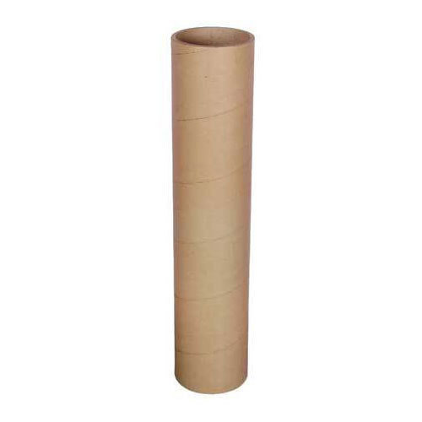
Vector
A vector is a contiguous storage container.
It is loaded through the back-end.
It can be resized.
Neary as efficient as arrays.
A vector of Strings: myVec
myVec.push_back(“Hello World”);
Front
Back
“Hello World”
Data cannot be loaded from the front

Slide 9
Vector Cont.
Since its back loaded, data can only be removed from the back
We can adjust data in the array using [index], but we can only remove from the back.
A vector of Strings: myVec
myVec.pop_back();
“Hello World”
Data cannot be removed from the front

Slide 10
Vector functions
vector() - default constructor - creates a container with no elements vector(int n) - creates a container with n elements vector(int n, const T& t) - creates a container with n elements, each initialized to value t vector(const vector& v) - copies the contents of container v into the current object ~vector() - destroys the container vector& operator=(const vector& v) - copies the contents of container v into the current object size_t size() const - returns the number of elements in the current object size_t capacity() const - returns the current capacity of the current object bool empty() const - returns true if the current object has no elements T& operator[](size_t i) - returns a reference to element i const T& operator[](size_t i) const - returns an unmodifiable reference to element i | T& at(size_t i) - returns a reference to element i and checks bounds - throwing an exception const T& at(size_t i) const - returns an unmodifiable reference to element i and checks bounds - throwing an exception T* data() noexcept - returns a pointer to the underlying array const T* data() const noexcept - returns a pointer to the underlying unmodifiable array T& front() - returns a reference to the first element const T& front() const - returns an unmodifiable reference to the first element T& back() - returns a reference to the last element const T& back() const - returns an unmodifiable reference to the last element void push_back(const T& t) - adds element t after the last element in the container void pop_back() - removes the last element from the container void clear() - removes all elements from the container

Slide 11
Deque
A deque is a non-contiguous storage container. Meaning it’s data is scattered throughout memory
It is double-ended so we can change its size from either end.
Adding from front and back is easy but accessing data in the middle is harder
myDeq.push_front(“PC Load Letter”);
A vector of Strings: myDeq
myDeq.push_back(“Hello World”);
“Hello World”
“PC Load Letter”
Data can be added from the front and back

Slide 12
Deque Cont.
Data can be removed from the front and rear easily.
This is done be changing the front or rear reference to the next element and then dropping/deleting the original
myDeq. pop_front);
A vector of Strings: myDeq
myDeq.pop_back();
“PC Load Letter”
“Hello World”
Data can be removed from the front and back

Slide 13
Deque Functions
deque() - default constructor - creates an empty container deque(int n) - creates a container with n elements deque(int n, const T& d) - creates a container with n elements, each initialized to value d deque(const deque& d) - copies the contents of d into the current object ~deque() - destroys the container deque& operator=(const deque& d) - copies the contents of container d into the current object size_t size() const - returns the number of elements in the current object size_t capacity() const - returns the current capacity of the current object bool empty() const - returns true if the current object has no elements T& operator[](size_t i) - returns a reference to element i const T& operator[](size_t i) const - returns an unmodifiable reference to element i | T& at(size_t i) - returns a reference to element i, checks bounds - throwing an exception const T& at(size_t i) const - returns an unmodifiable reference to element i, checks bounds - throwing an exception T& front() - returns a reference to the first element const T& front() const - returns an unmodifiable reference to the first element T& back() - returns a reference to the last element const T& back() const - returns an unmodifiable reference to the last element void push_back(const T& t) - adds element t after the last element in the container void push_front(const T& t) - adds element t before the first element in the container void pop_back() - removes the last element from the container void pop_front() - removes the first element from the container void clear() - removes all elements from the container

Slide 14
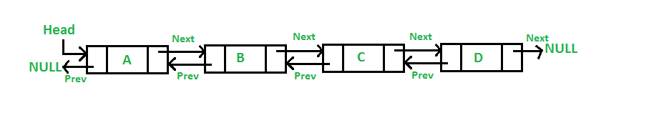
List
A list uses non-contiguous storage to contain it’s data.
It is a double-linked list so each node can point to the next or previous node.
A node is like a bubble that contains the data and references to other nodes.
Since lists use nodes, they aren’t as efficient as arrays, but they have more functionality than deques or vectors
This is a node
Reference to previous node
Reference to next node
Data stored

Slide 15
List cont.
Lists can insert anywhere in the list and can remove anywhere in the list
The incoming data node is then placed at an iterator position.
Legend:
Old | New
A list of Strings: myList
myList.insert(1, “New String”);
[1]
“New String”
Null
Null
“PC Load Letter”
“Hello World”
Null
[0]
[1]

Slide 16
Container Adapters
We can change our containers to operate in a certain fashion
There are stack, queue, and priority_queue
With these adapters, we have 2 methods of adding/removing data
Last in, first out (LIFO)
First In, First Out (FIFO)
Priority, This object has highest priority so it comes first

Slide 17

Stack
This is a last in, first out adapter
You can’t get this bottle without
taking out the others first
Number 4 was the last in so it will be the first out
4
3
2
1
0
Number 0 is the first one in so it can
only come out after all of the ones on top come out

Slide 18
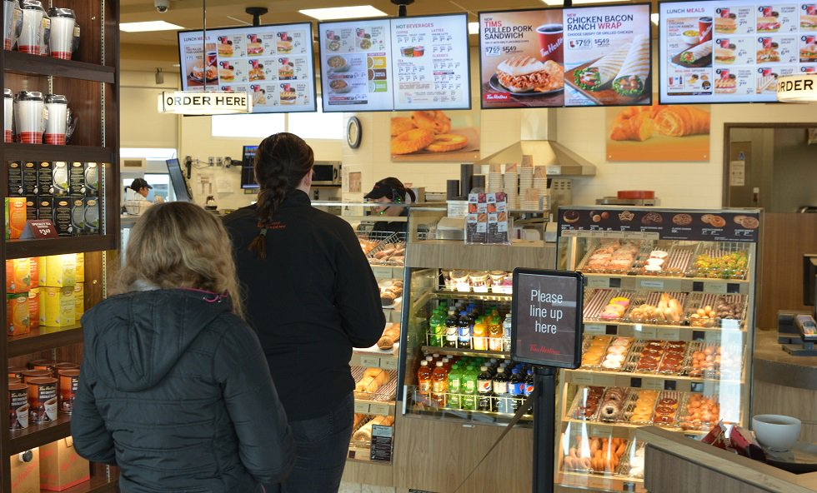
Queue
Queues are a first in, first out adapter
Think of them as lines at tim hortons
Number 4 was the last in so it will be the last out
4
3
2
1
0
Number 0 is the First one in so it First Out
She was first in line,
So she will be served first.
These are called queues

Slide 19

Priority Queues
These work the same as queues, except the first entry holds any items with a high priority.
Think of these like hospital waiting rooms
Number 4 was the last in so it will be the last out
She has a high priority
4
[3]
3
[2]
2
[1]
[0]
1
0
Number 1 is the First one in so it First Out, unless
0 has a higher priority item

Slide 20

You guys are my #0 class!!

